Slide 1
FAKE BLITZ
AI COUNTERFEIT DETECTION SOLUTION
K740 – WINTER 2023 – TEAM 6

Slide 2





MEET THE TEAM
THE INNOVATIVE POWERHOUSE
ANTONY
BRITTO
ELIZABETH ADEYINFA
HAMZA
KHAN
RIA
BANDYOPADHYAY
YIDI
GENG

Slide 3
THE
01 | THE COUNTERFEIT MARKET
02 | BUSINESS UNDERSTANDING
03 | DATA UNDERSTANDING & KEY RESOURCES
04 | DATA PREPARATION
05 | DATA MODELLING
06 | COST-BENEFIT ANALYSIS
07 | AI SOLUTION APPLICATION
08 | COMPETITOR ANALYSIS
09 | ETHICAL, LEGAL & OPERATIONAL CONSIDERATIONS
 | APPENDIX
10 | SOLUTION ARCHITECTURE DIAGRAM
11 | COST-BENEFIT ANALYSIS: REVENUE CALCULATIONS
12 | RISK & MITIGATION
13 | AI SOLUTION WEBSITE
AGENDA
Notes:
In the first half of the presentation we will be addressing the counterfeit market and the crucial early stages of the CRISP DM model. In the second half, we will analyze the business and legal aspect of our solution

Slide 4
01
THE COUNTERFEIT MARKET

Slide 5
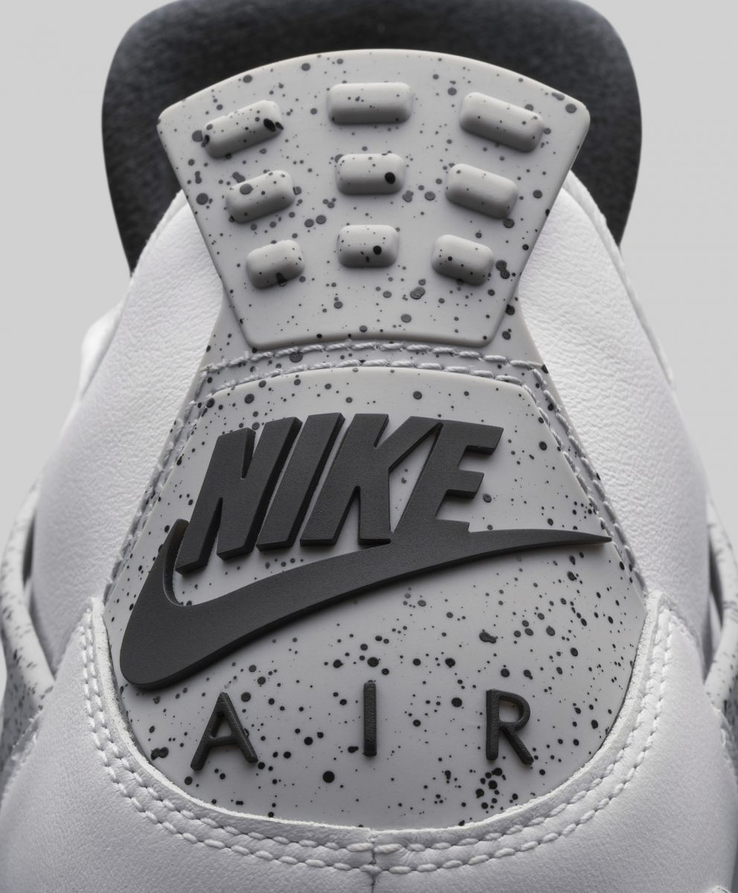
COUNTERFEIT PRODUCTS
DEFINITION Imitation of something valuable or important with the intention to deceive or defraud | THE SNEAKER INDUSTRY | US$75.77 Billion Authentic Sneaker Revenue
WORLDWIDE PROBLEM The total amount of counterfeit goods sold each year - CA$1.7 Trillion to $4.5 Trillion |  | 5.31% Authentic Sneaker CAGR (2023-2028)
IMPACT ON THE CANADIAN ECONOMY CA$20-30 Billion |  | US$450 Billion Counterfeit Sneaker Revenue
CONTRIBUTING FACTORS Branded products Easily replicable packaging |  | United States Largest Counterfeit Sneaker Market
THE MARKET TODAY
4
Notes:
LINK: https://www.washingtonpost.com/business/2022/09/30/sneaker-authentication-ebay-stockx-nike/

Slide 6
02
BUSINESS UNDERSTANDING

Slide 7

BUSINESS PROBLEM
“
How can we mitigate the sale of counterfeit products in the sneaker industry?
”
6

Slide 8

OUR SOLUTION
Create a multiplatform AI solution that can identify counterfeit sneakers within a high accuracy rate
7

Slide 9
03
DATA UNDERSTANDING & KEY RESOURCES

Slide 10
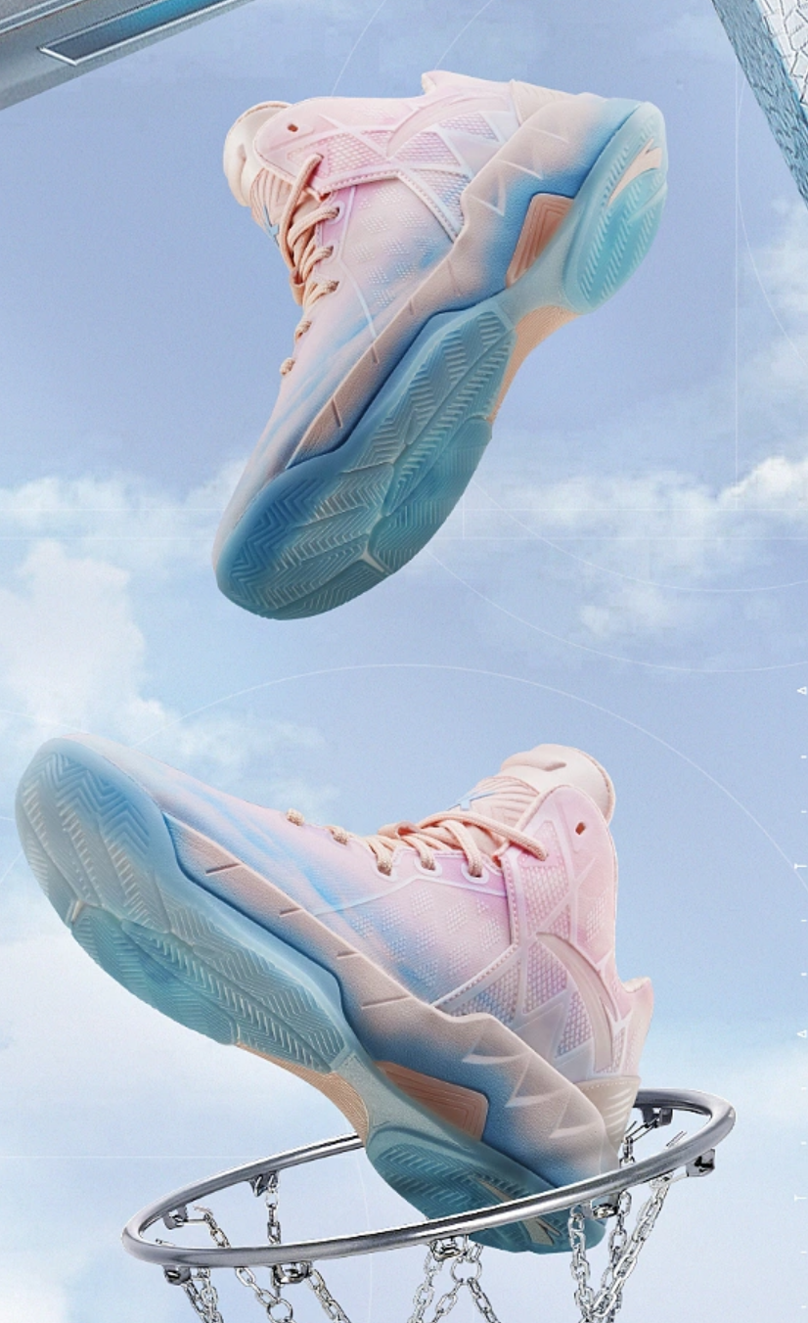
DATA UNDERSTANDING & KEY RESOURCES
FOUNDATIONS OF OUR AI SOLUTION
DATA
Unstructured data
Structured data
From existing brand databases and factories
MACHINE LEARNING MODEL
Computer Vision: Shape and logo recognition
Naural Language Processing: Text analysis
DEVELOPMENT TOOL & LANGUAGE
Cross-Platform Development Tools (React Native)
Java or Swift
GitHub
PyCharm or Jupyter Notebook
9

Slide 11
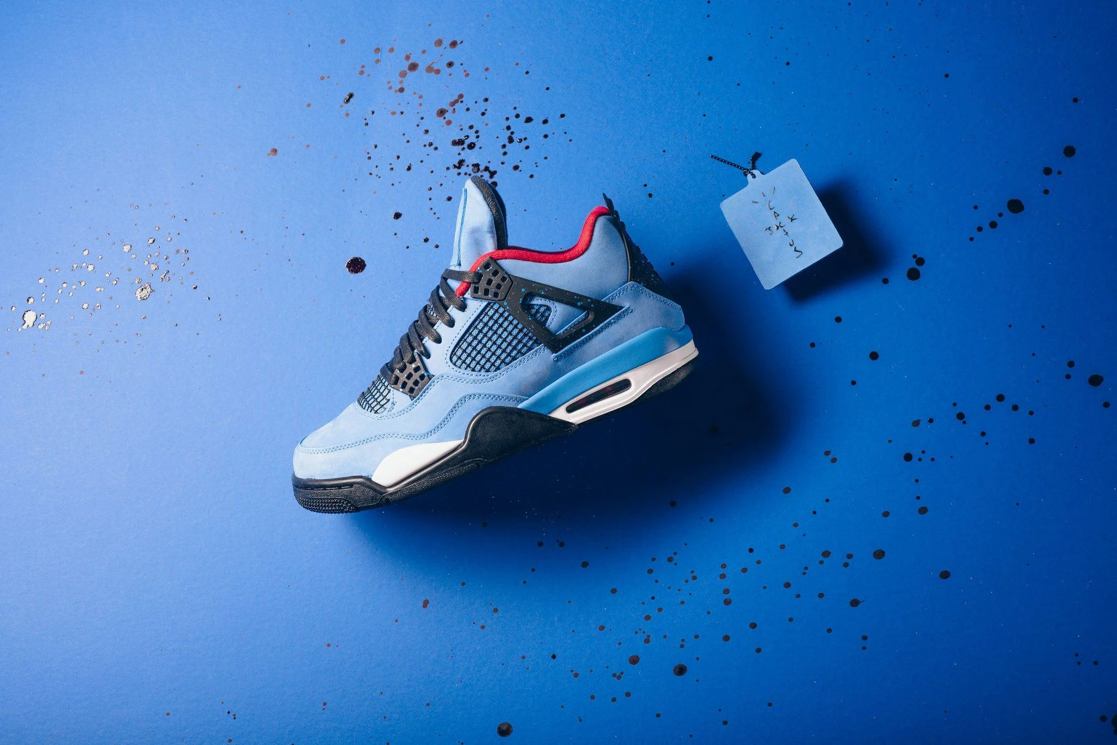
DATA UNDERSTANDING & KEY RESOURCES
FOUNDATIONS OF OUR AI SOLUTION
ADVANCED INTERNET & TECH SUPPORT
QUALITY ASSURANCE & TESTING
HUMAN RESOURCES
High-Performance Computing resources
GPUs
high-speed internet
APIs
Payment - PayPal
Google Cloud Storage
Push Notification - Google Cloud Messaging
Counterfeit sneakers
Retail market
Amazon and eBay
Mobile App Developer
Web Developer
UX/UI Designer
Machine Learning Engineer
Quality Assurance (QA)
Marketing Specialist
10

Slide 12
04
DATA PREPARATION

Slide 13

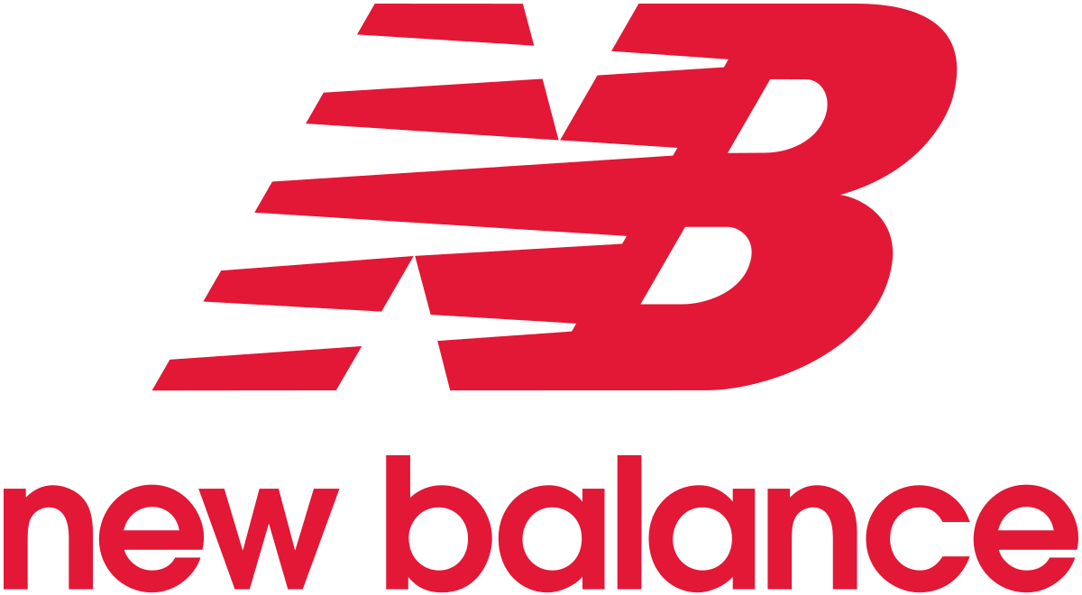








DATA PREPARATION
DATA RESOURCES
BRAND PARTNERSHIP
TEXT DATA
Metadata
User Feedback
CATEGORICAL DATA
Structured data
Historical data
ONLINE SOURCES
NUMERICAL DATA
Image data
Pixel data
12

Slide 14
DATA PREPARATION
CLEANSING PROCESS
Drop Duplicates
Remove Outliers
to avoid skewness
01
04
Drop Redundant Columns & Rows
Detect and Impute
Missing Values
02
05
Fix Structural Errors / Miscellaneous Values
Test to ensure usability of Data
03
06
13

Slide 15
DATA PREPARATION
DETAILED PROCESS
Collect & Organize Data Sources
Feature Extraction
Second Data Cleaning
01
05
09
First Data Cleaning
Data Scraping
Labelling Original & Fake Product Data
02
06
10
Data Normalization
Data Parsing
03
07
Image Pre-Processing
Data Integration
04
08
14
Notes:
Icons

Slide 16
05
DATA MODELLING

Slide 17
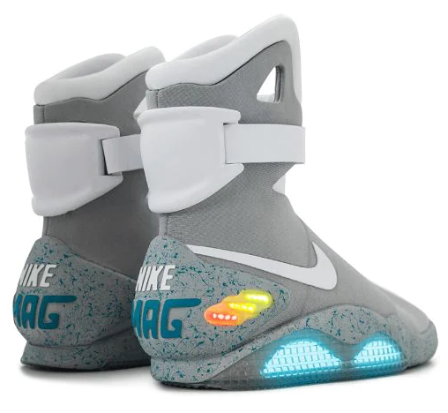
TEXT ANALYSIS/ SPELLING DETECTION Analyze text on labels and packaging: detect spelling errors, font inconsistencies, etc.
TEXTURE RECOGNITION Recognize unique features: logo placement, stitching, and materials
IMAGE RECOGNITION Analyze high-resolution images to detect subtle differences (including patterns, color, and texture of sneakers)
SHAPE DETECTION (LOGO) Process pixel data of images, feed historical data, match & identify differences
COLOR DETECTION Based on RGB color code palette- differences in subtle shades
DATA MODELLING
AI TECHNOLOGY
1
2
3
2
1
3
16
Notes:
This data can be sourced from :
Partnering with major manufacturers like Nike, Air Jordan and Adidas
Public datasets: There are several public datasets available online that contain images of sneakers, including both real and counterfeit ones. Ex Kaggle, github, UCI Machine Learning Repository and government data sets which contains data on seized counterfeit products.
Text Data
Metadata: This type of data consists of the products data like the Brand, Model, Size, Location and Price. This can be stored in a variety of formats, including CSV (Comma Separated Values), JSON (JavaScript Object Notation), or XML (Extensible Markup Language).
User Feedback: This type of data can be stored in various formats, including CSV, HTML (Hypertext Markup Language), or a database format such as SQL (Structured Query Language).
Categorical Data
Structured data: Structured data can include information on product features such as size, color, material, of the logo. This data can be in various formats, including CSV and SQL databases.
Historical data: The AI/ML model can be trained on historical data of authentic and counterfeit sneakers. This data can be used to identify patterns and differences between the logos two types of sneakers.
Numeric Data
Image & Pixel data: Includes numeric values of the pixel values. Images of authentic and counterfeit sneakers can be used to train an AI model to identify visual differences between the logos of two types of products. Images can be in various formats, including JPEG, PNG, and BMP.

Slide 18
DATA MODELLING
ML ALGORITHMS
NAÏVE BAYES CLASSIFIER
High prediction accuracy on public datasets compared to models and other classifiers (multiple datasets)
Authentic sneakers datasets compared to models- identify faulty counterfeit patterns and gaps
LOGISTIC
REGRESSION
Uses binary classification in linearly separable class
Probability of model to belong to either class
Given input logo of any sneaker
Compare to authentic logo and identify counterfeit image
DEEP LEARNING
Learn from large datasets of both real and counterfeit sneakers to detect patterns that differentiate them
Given any random input will identify whether matches with authentic or fake and identify counterfeit
17

Slide 19
06
COST-BENEFIT ANALYSIS

Slide 20
COST-BENEFIT ANALYSIS
KEY COMPONENTS
INITIATE
DESIGN
BUILD
DEPLOY
VALUE REALIZATION
COSTS
BENEFITS
DIRECT
INDIRECT
MONETARY
NON-MONETARY
Data Acquisition & Preparation
Development Team
Infrastructure & Tools
Testing & Evaluation
Marketing & Advertising
Opportunity Cost
Training Cost
Infrastructure Upgrades
Legal & Regulatory Compliance
Maintenance & Updates
Subscription Revenue
Recurring Revenue With New Features
Process Efficiency
Process Effectiveness
Customer Satisfaction
Market Intelligence
Improved Reputation & Brand Recognition
19
Notes:
As we know, AI projects require significant investments in terms of time, money, and resources. Before starting any project, it's crucial to understand the costs and benefits associated with it.
In reviewing cost, there are 2 forms – direct and indirect, which encompass the costs of developing of our solution and activities that enable our solution to continue after development and evolve.
When discussing benefits, this can also be broken down into 2 parts – monetary and non-monetary. Where monetary benefits include all forms of revenue and possible revenue generation from awareness; and non-monetary benefits that could be realized regarding efficiency and performance.

Slide 21
COST-BENEFIT ANALYSIS
ESTIMATED CBA
 | OPTION 1: DIGITAL VERIFICATION | OPTION 2: HOLOGRAM LABELLING
Direct Cost | $727,853.00 | $682,403.00
Indirect Cost | $625,742.80 | $609,550.88
Total Cost | $1,353,595.80 | $3,727,111
Monetary Benefits | $4,850,448.00 | $6,007,022.05
CBA | $3,496,852.20 | $2,279,911.05
Payback Period (months) | 3.35 | 7.45
Cost-Benefit Ratio | 3.58 | 1.61
20
Notes:
There are many possible solutions to mitigate counterfeiting using AI, such as RIFD tags, self-service tools, and product serialization codes.
FAKEBLITZ wanted something that was mobile instead of sediment, could be used by both enterprise and individual consumers, and did not require many hardware or device attachments to produce or purchase.
Thus, it came down to two options: a digital verification application using your smartphone or hologram labeling with an application to verify.
Conducting a cost-benefit analysis, we concluded that option 1 was the most profitable option for our company to pursue, with an estimated CBA of ~$3.5 Millon in the first-year and a quick payback period. This option will be easy to scale given cloud computing capabilities and software updates.
.

Slide 22
07
AI SOLUTION APPLICATION
Notes:
With that being said, let’s take a look at how our solution would be leveraged from an individual consumers point of view

Slide 23


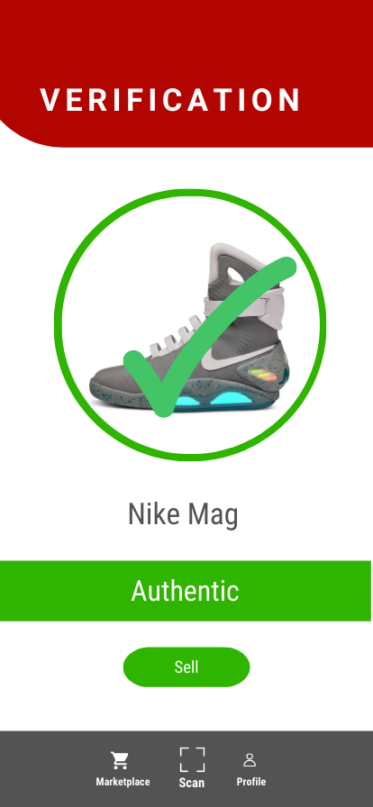
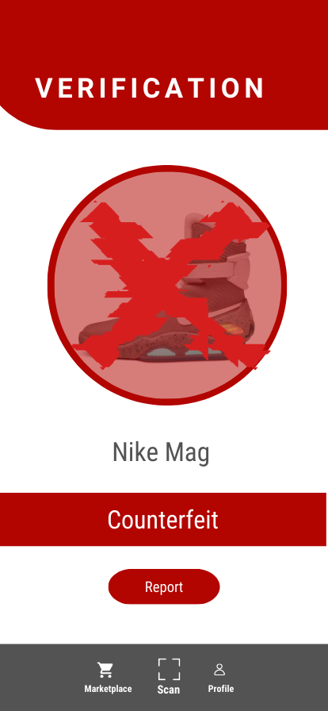
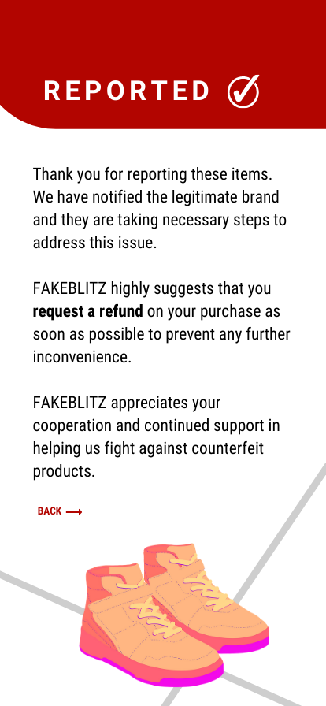
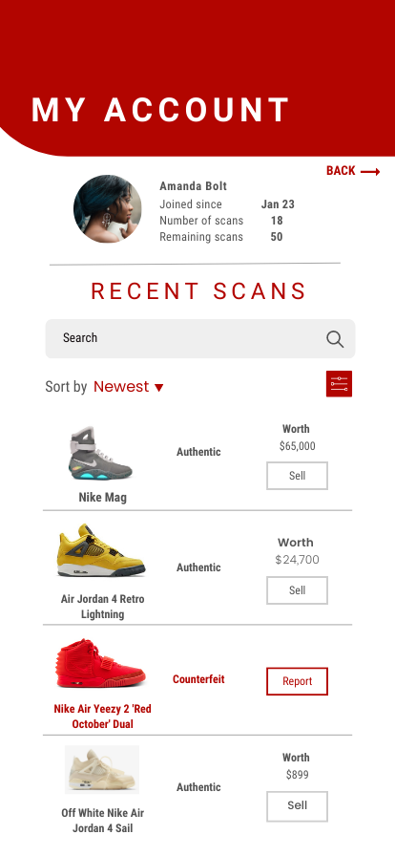
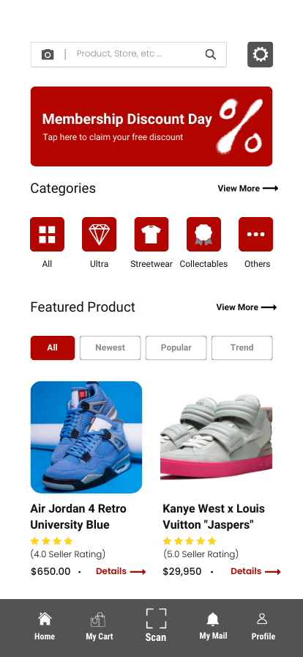
FAKEBLITZ AI SOLUTION
MOBLIE APPLICATION
22
Notes:
With our solution, a consumer can simply upload or ‘scan’ a video or image of their sneaker, receive instant verification of whether it is authentic or not – immediately sell or report the sneaker

Slide 24
08
COMPETITOR ANALYSIS

Slide 25
COMPETITOR ANALYSIS
DIRECT & INDIRECT COMPETITORS
Features | VISUA | CheckCheck | Amazon Rekognition | FAKEBLITZ
Logo Detection | X | X | X | X
Text Detection | X | X | X | X
Custom Object Detection | X |  | X | X
Image Processing Analysis | X | X | X | X
Image Classification | X |  |  | X
Instant Logo Learning | X | X |  | X
Counterfeit Reporting |  |  |  | X
End-user Flexibility |  |  |  | X
Auto Resell / Marketplace |  |  |  | X
24
Notes:
In today's fast-paced business world, it's important to understand our potential competitors in order to stay ahead of the game. In analyzing our competitors, we have identified that our competitive advantage upon entrance would be (1) instant counterfeit reporting directly to the authentic brand to initiate cease and assist orders, (2) a solution that exists in both mobile and web format, and (3) a direct connection to a reselling marketplace within the application.
LINKS
https://visua.com/computer-vision-api-comparison-guides
https://www.cbinsights.com/company/marqvision

Slide 26
09
ETHICAL, LEGAL & OPERATIONAL CONSIDERATIONS

Slide 27
ETHICAL, LEGAL & OPERATIONAL CONSIDERATIONS
SENSITIVITIES AROUND AI IMPLEMENTATION
ETHICAL
LEGAL
OPERATIONAL
Exposing counterfeit sellers
Objective authentication of products
Accessibility of technology to everyone
Intellectual property considerations
Canadian patent search, filing, monitoring and licensing
Extensive measures to avoid false positives
Awareness of business strategy and model
Development of early warning signs and “on the spot” warning signs
Establish trusted suppliers
Keep manufacturing operations in house
Potential unemployment
26
Notes:
Ethical
Precise justification as to whether a product is counterfeit or not
Legal
Leveraging Government of Canada sources, Canadian Intellectual Property Office, and Canadian Anti-Counterfeiting Network
These sources would be leveraged by our company
Operational

Slide 28
THANK YOU
Q&A

Slide 29
APPENDIX

Slide 30
1
0
SOLUTION ARCHITECTURE DIAGRAM

Slide 31


DATA MODELLING
FAKEBLITZ ARCHITECTURE DIAGRAM
Direct Integration
FakeBlitz APIs*
Visualization
Result
Customer Data
Product API
Counterfeit API
Image & Video
Video API
Supply Chain API
Imagery API
Google Cloud API
Point of Sale API
REST API
Expose data via APIs
SOLUTION KPIs
Accuracy
False Positive Rate
Speed
Cost Savings
User Satisfaction
Data Storage
(Google Cloud)
Data Integration
Brand Data
Brand Partner
Event Stream
Online Data
AI/ML Capabilities
*Complete API will be outlined in final report
29

Slide 32
Direct Integration
FAKEBLITZ APIs
Customer Data
D
E
Product API
Counterfeit API
Image & Video
Video API
Supply Chain API
Imagery API
Google Cloud API
Point of Sale API
REST API
Expose data via APIs
C
Data Storage
(Google Cloud)
Data Integration
Visualization
Result
Brand Data
Brand Partner
B
Event Stream
F
A
Online Data
AI/ML Capabilities

Slide 33
1
1
COST-BENEFIT ANALYSIS
REVENUE CALCULATIONS

Slide 34
OPTION 1: COST-BENEFIT ANALYSIS
ESTIMATED REVENUE SUBSCRIPTION
 | Optimistic |  | Most Likely |  | Pessimistic
 | Sneaker Enthusiasts | Sneaker Resellers | Sneaker Enthusiasts | Sneaker Resellers | Sneaker Enthusiasts | Sneaker Resellers
Cost of Development | $1,327,054.71 | $26,541.09 | $1,330,533.22 | $23,062.58 | $1,348,202.99 | $5,392.81
Profit Margin | 60% | 70% | 55% | 65% | 50% | 60%
Est. Subscribers | 25,000 | 500 | 15,000 | 260 | 5,000 | 20
Annual Cost Per User | $53.08 | $53.08 | $88.70 | $88.70 | $269.64 | $269.64
Annual Price | $84.93 | $90.24 | $137.49 | $146.36 | $404.46 | $431.42
Monthly Price Per User | $8.00 | $8.00 | $12.00 | $13.00 | $34.00 | $36.00
Annual Revenue | $2,123,287.53 | $45,119.86 | $2,062,326.50 | $38,053.25 | $2,022,304.48 | $8,628.50
Photo Verification Price | $3.20 | $3.20 | $4.80 | $5.20 | $13.60 | $14.40
Video Verification Price | $4.80 | $4.80 | $7.20 | $7.80 | $20.40 | $21.60
Monthly Marketplace Access | $12.00 | $45.00 | $10.00 | $35.00 | $8.00 | $30.00
Number of Monthly Scans | 50,000 | 5,000 | 30,000 | 2,600 | 10,000 | 200
Monthly Photo Revenue | $160,000.00 | $16,000.00 | $144,000.00 | $13,520.00 | $136,000.00 | $2,880.00
Monthly Video Revenue | $240,000.00 | $24,000.00 | $216,000.00 | $20,280.00 | $204,000.00 | $4,320.00
Monthly Marketplace Revenue | $600,000.00 | $225,000.00 | $300,000.00 | $91,000.00 | $80,000.00 | $6,000.00
Total Monthly Revenue | $1,000,000.00 | $265,000.00 | $660,000.00 | $124,800.00 | $420,000.00 | $13,200.00
Sum |  | $1,265,000.00 |  | $784,800.00 |  | $433,200.00
Real Est. of Monthly Revenue |  | $506,000.00 |  | $313,920.00 |  | $173,280.00
Annual Real Est. Of Revenue (40%) |  | $6,072,000.00 |  | $3,767,040.00 |  | $2,079,360.00
31

Slide 35
OPTION 2: COST-BENEFIT ANALYSIS
ESTIMATED REVENUE SUBSCRIPTION
 | Optimistic | Most Likely | Pessimistic
 | Partners & Sneaker Resellers | Partners & Sneaker Resellers | Partners & Sneaker Resellers
Cost of Development | $3,727,111.00 | $3,727,111.00 | $3,727,111.00
Profit Margin | 60% | 55% | 50%
Est. Subscribers | 2000 | 1,100 | 200
Annual Cost Per User | $1,863.56 | $3,388.28 | $18,635.56
Annual Price | $2,981.69 | $5,251.84 | $27,953.33
Monthly Price Per User | $249.00 | $438.00 | $2,330.00
Annual Revenue | $5,963,377.60 | $5,777,022.05 | $5,590,666.50
32

Slide 36
1
2
RISK & MITIGATION

Slide 37
FAKEBLITZ’S
RISK MITIGATION PLAN
CATEGORY | IDENTIFIED RISK | MITIGATION PLAN
Technical | Performance issues or require technical support, causing extra expenses & delays | Ensure quality before deployment & provide ongoing technical support
Data Privacy | Improper handling, data breaches, and unauthorized access | Ensure strict data privacy compliance with GDPR and CCPA and employee training
Legal | IP infringement and legal violations in product authentication | Review legality, obtain brand licenses, comply with regulations, protect IP
Reputation | Inaccuracy of the application can lead to customer distrust | Mention solution accuracy & limitations, partner with reputable AI vendors
34

Slide 38
1
3
AI SOLUTION WEBSITE

Slide 39
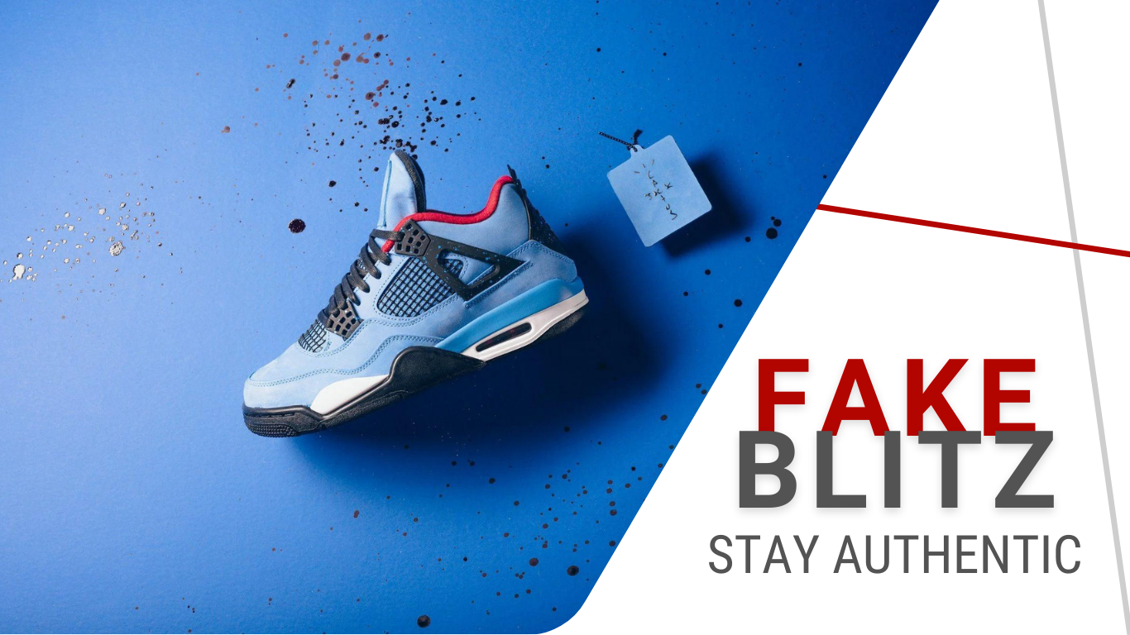
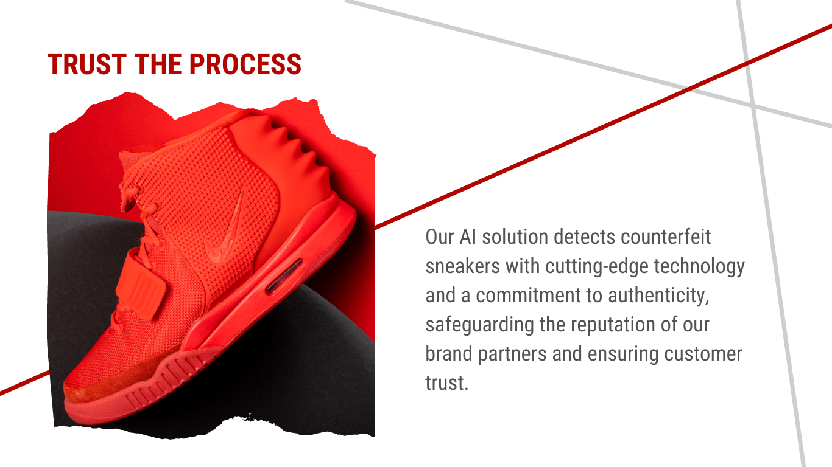
FAKEBLITZ
WEBSITE

Slide 40
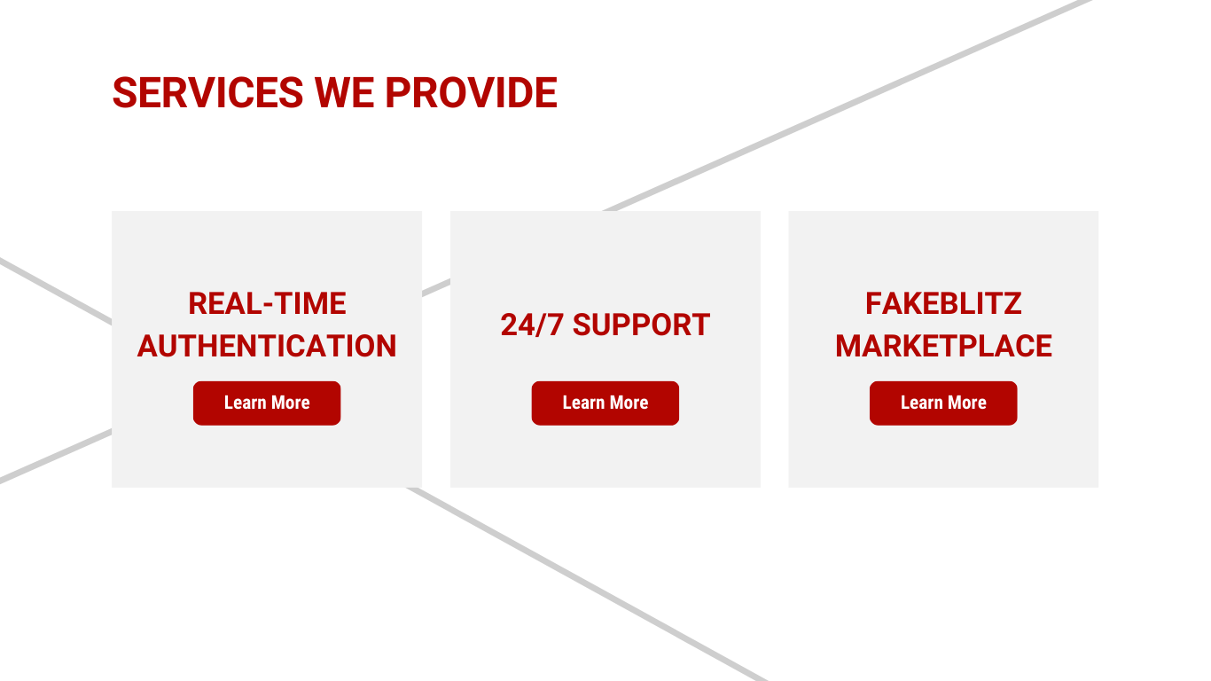
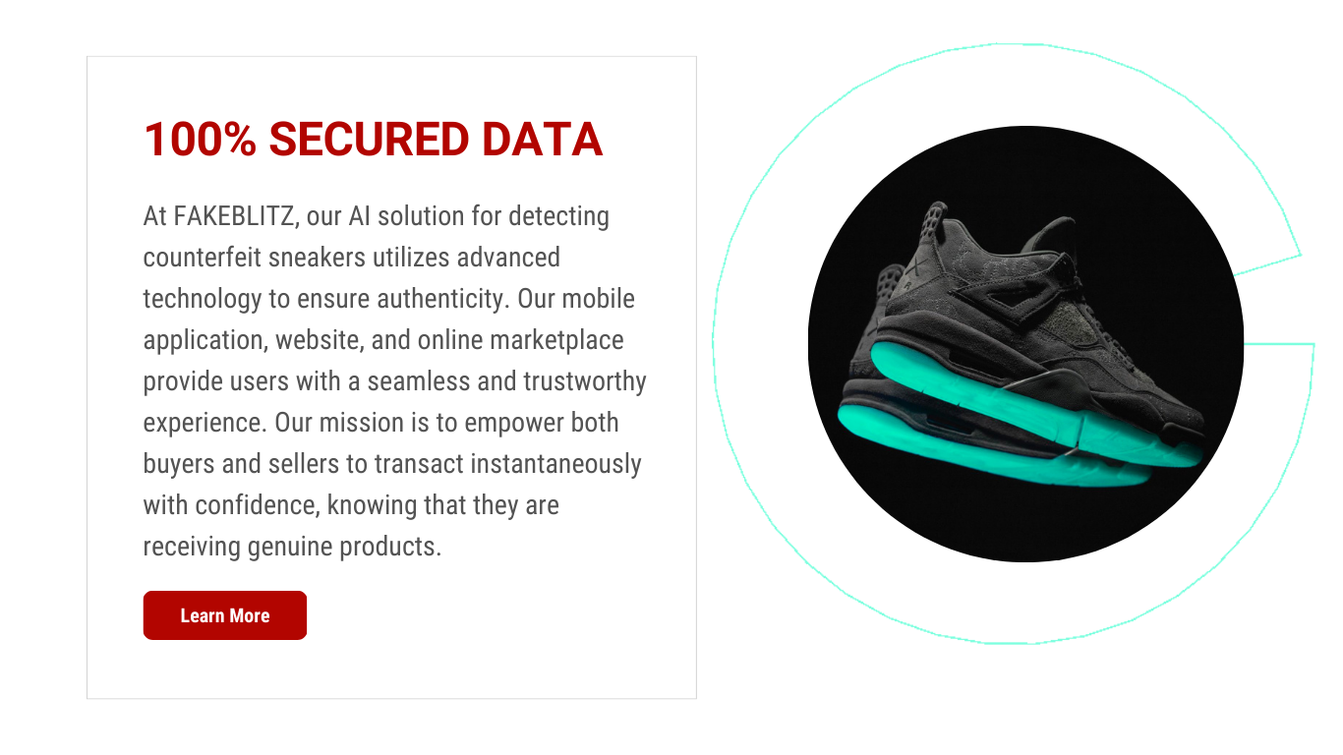
FAKEBLITZ
WEBSITE

